Slide 1
Micro Teaching Lesson Plan
Skill of Introduction

Slide 2
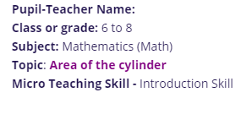

Slide 3
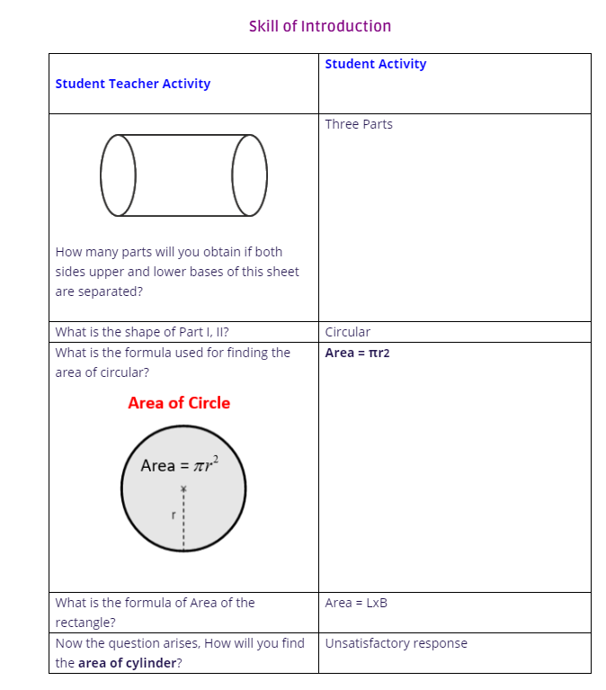

Slide 5
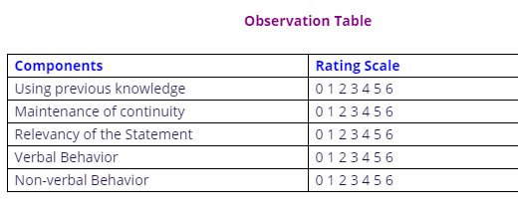
Observation Cum Rating Scale

Slide 6
Skill of probing questions

Slide 7
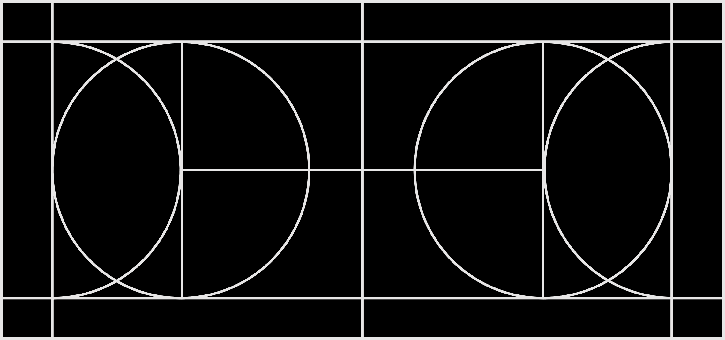
Micro Teaching Skill

Slide 8
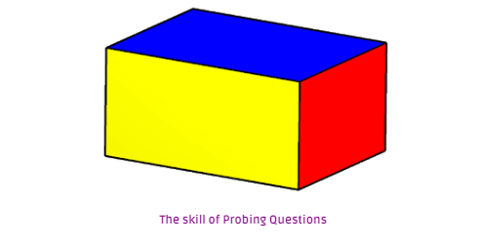

Slide 9
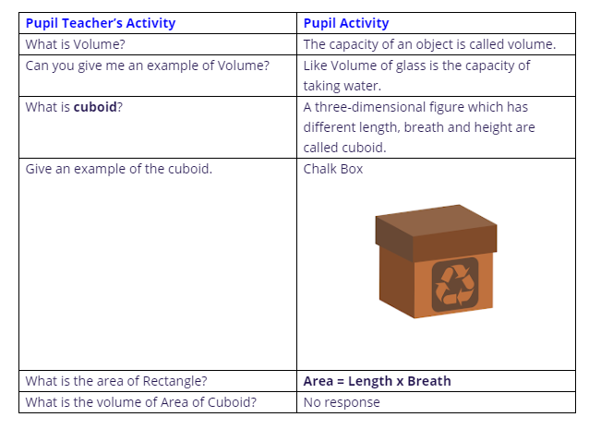
The Skill of Probing Questions

Slide 10
Observation Cum Rating Scale

Slide 12
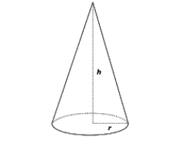
Figure

Slide 13
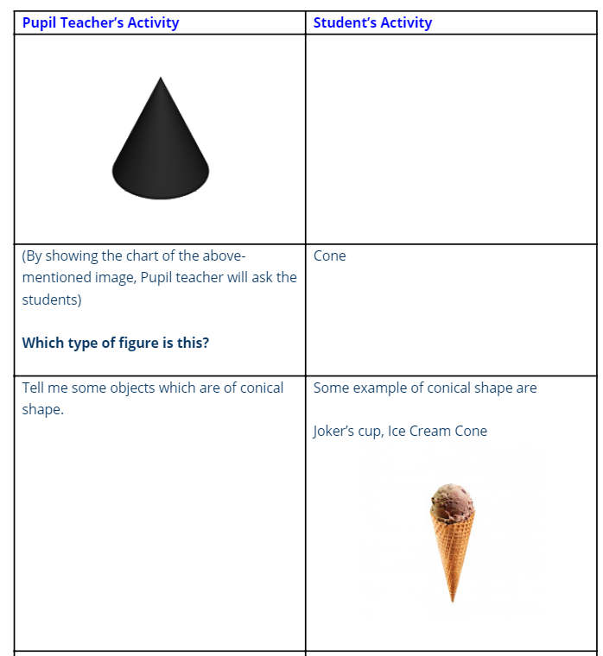
Micro lesson plan

Slide 14
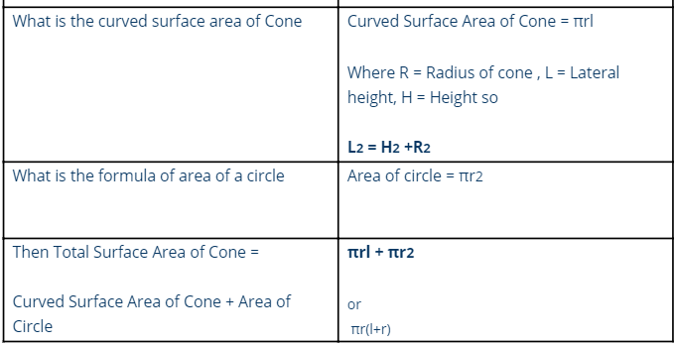
Micro lesson plan(cont.)

Slide 15
Observation Cum Rating Scale

Slide 17
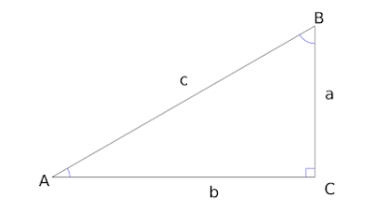

Slide 18
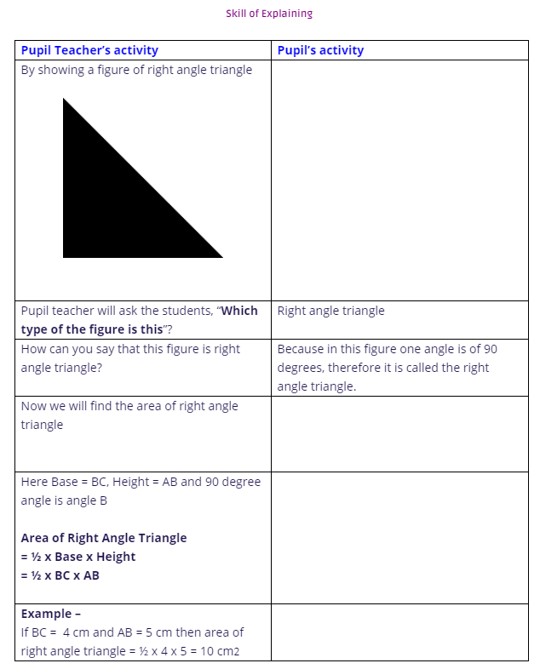

Slide 19
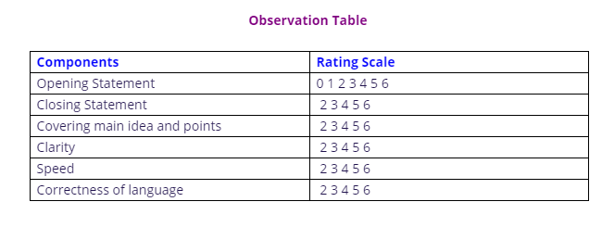
Observation Cum Rating Scale

Slide 21
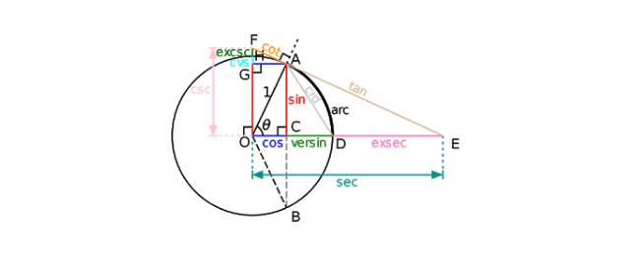

Slide 22
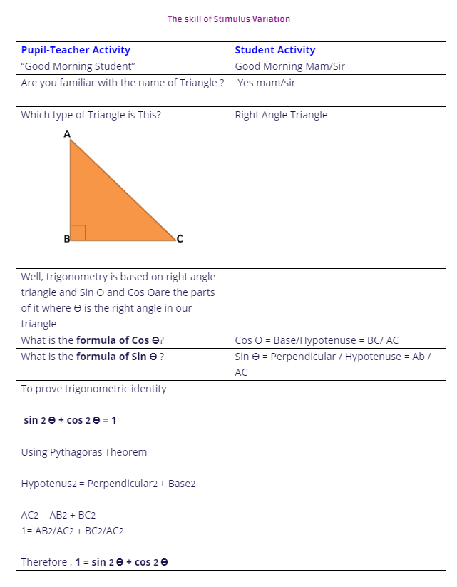

Slide 23
Observation Cum Rating Scale
Components | Rating Scale
Movement | 0 1 2 3 4 5 6
Gestures | 0 1 2 3 4 5 6
Voice Modulation | 0 1 2 3 4 5 6
Focusing | 0 1 2 3 4 5 6
Change in Interaction Style | 0 1 2 3 4 5 6
Pausing | 0 1 2 3 4 5 6
Oral Visual Switching | 0 1 2 3 4 5 6

